Slide 1


Tensor Serving using Docker
Deployment for trained tensorflow model

Slide 2
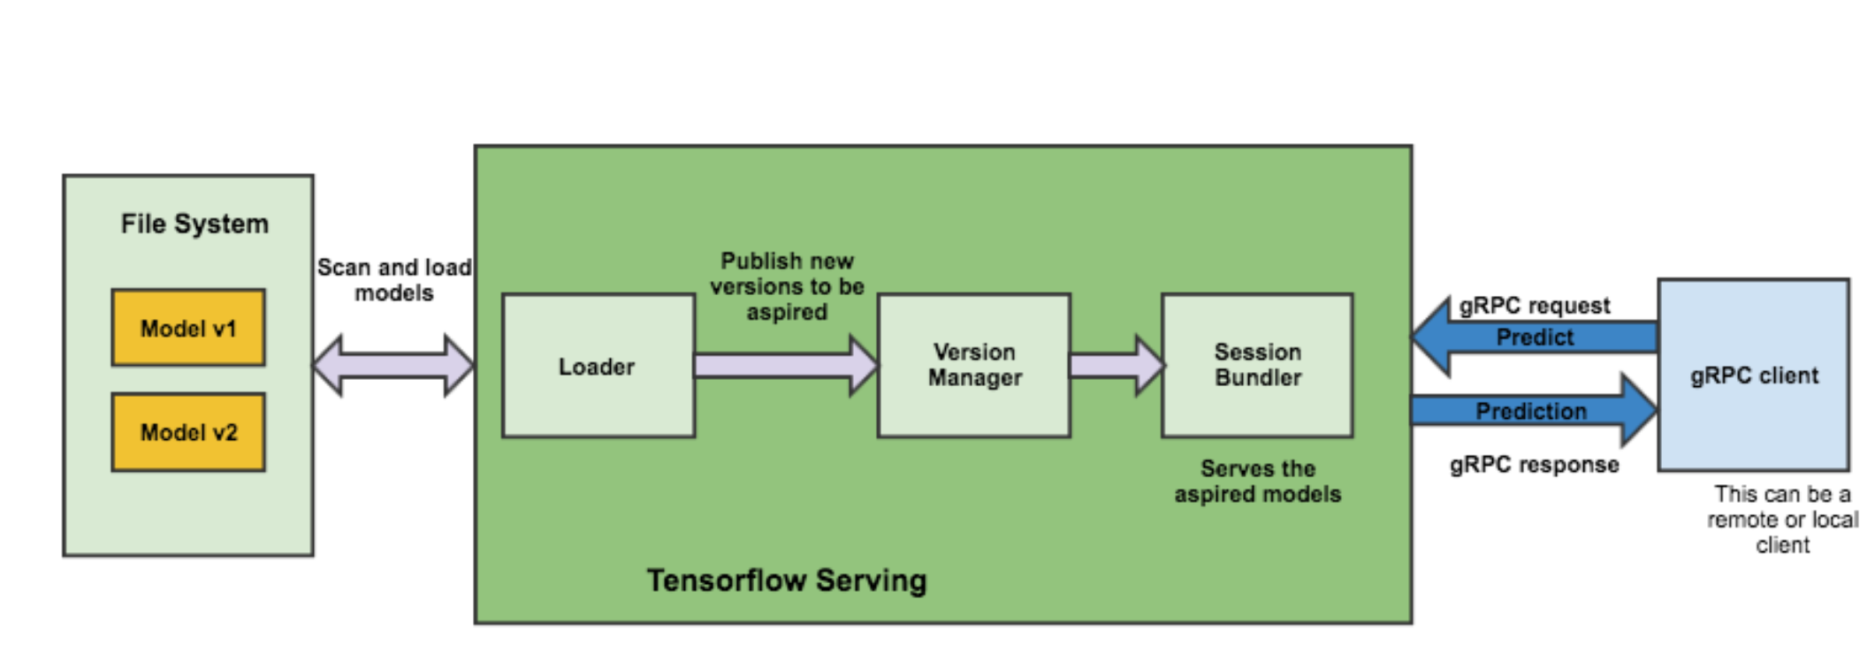
Architecture Overview
SERVER
CLIENT

Slide 3
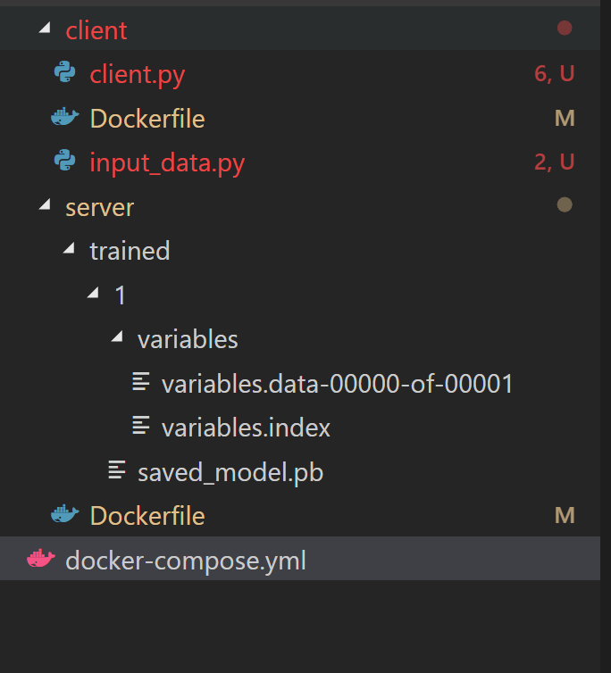
Scaffolding

Slide 4
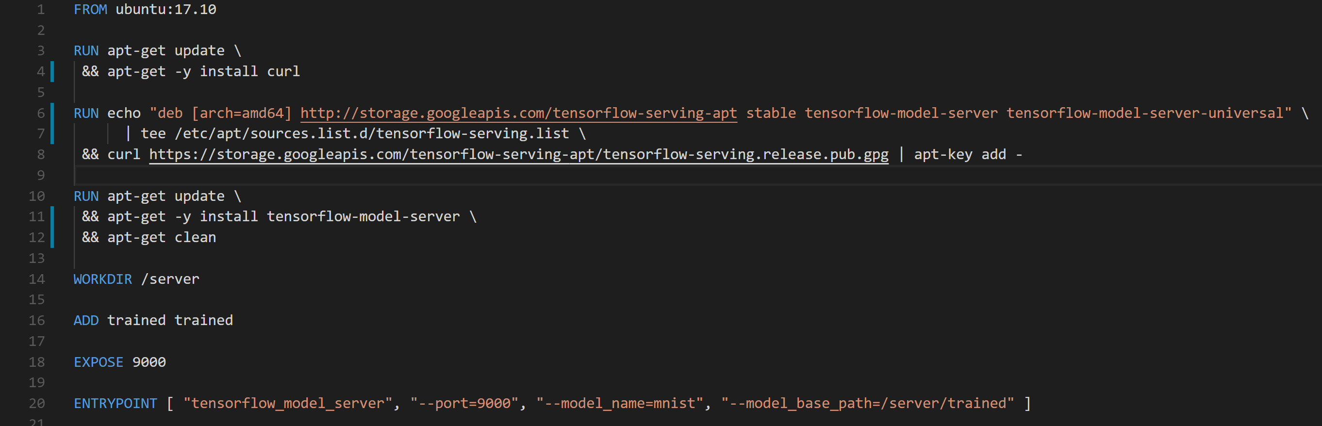
Server: Dockerfile

Slide 5
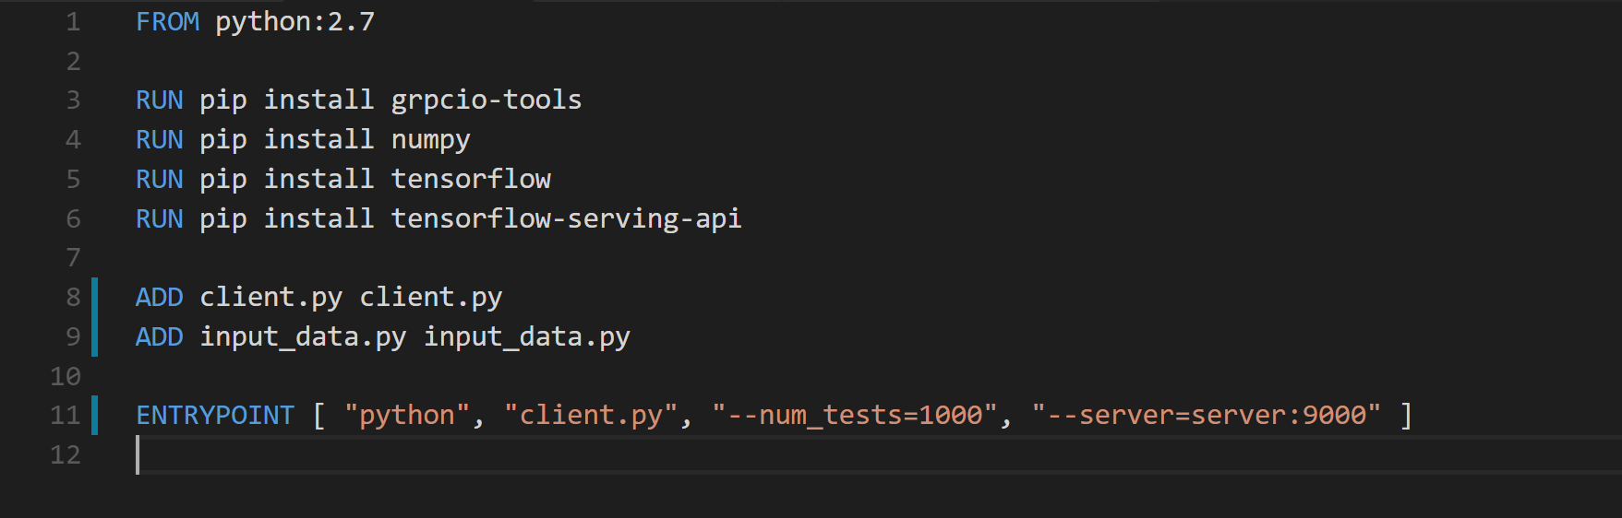
Client: Dockerfile

Slide 6
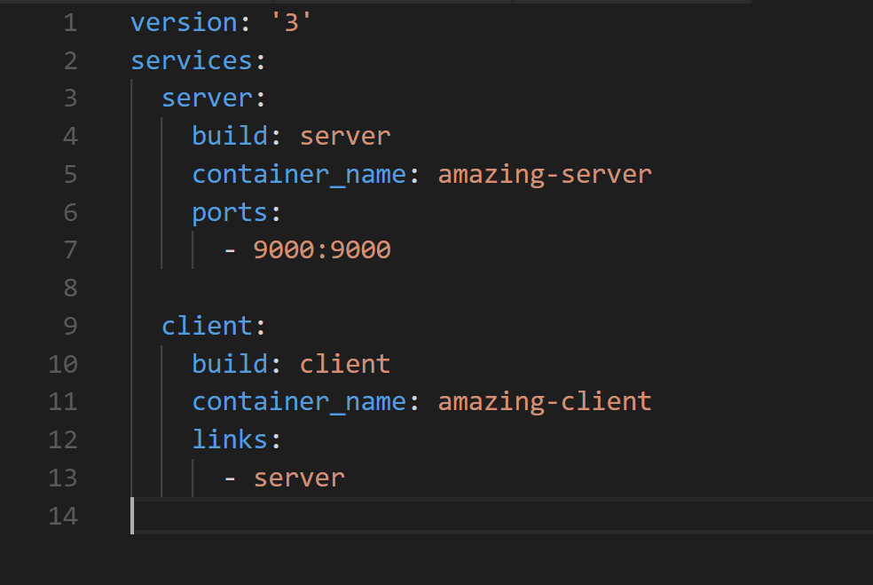
Orchestrator

Slide 7
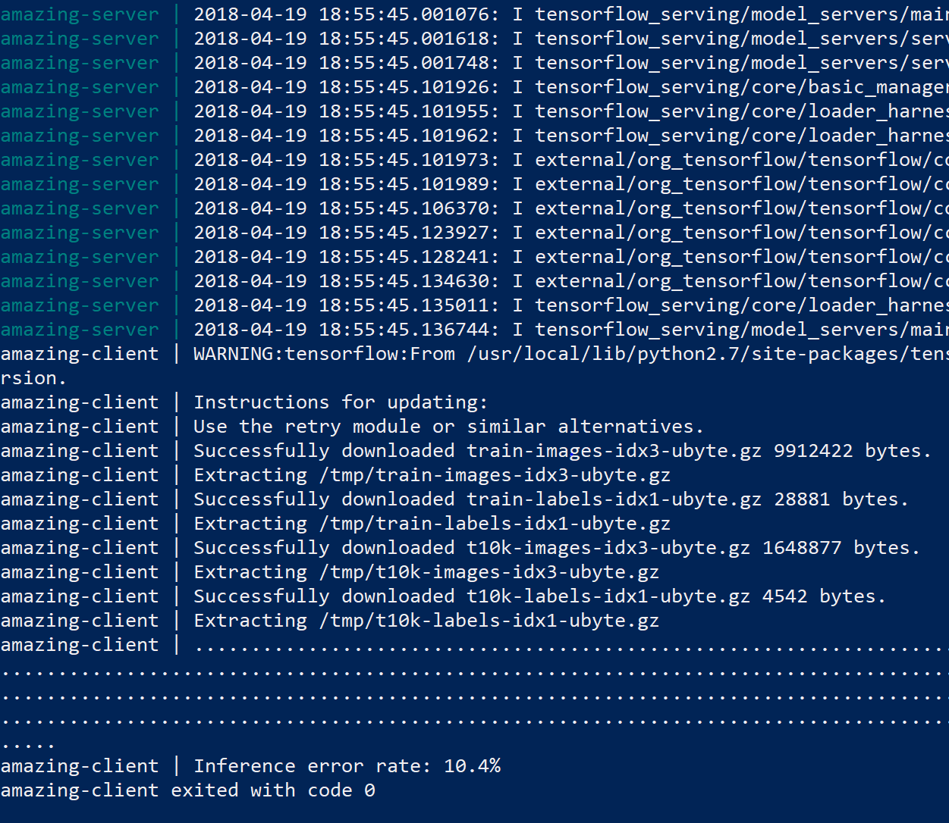
Fire in the hole!

Slide 8
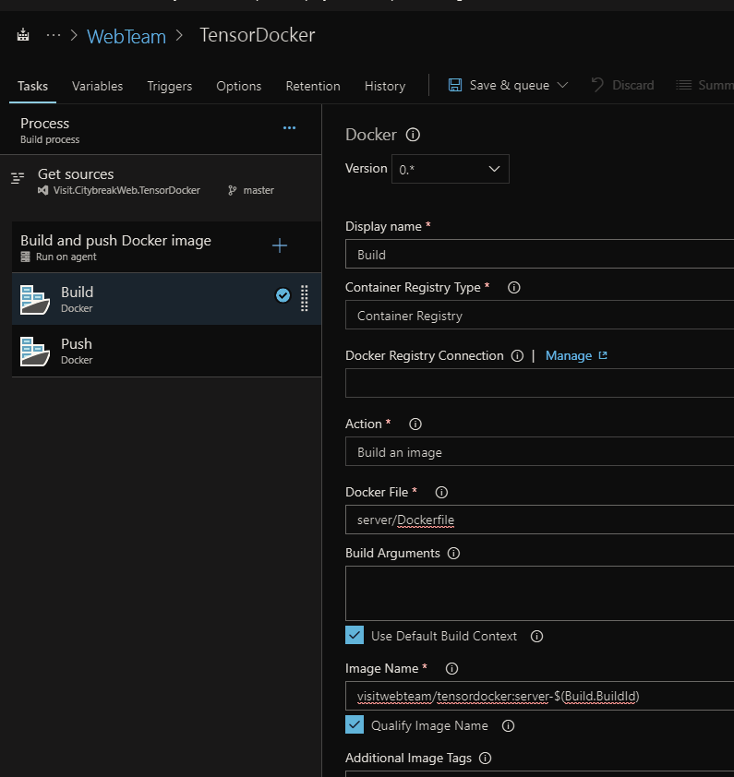
It builds! Deploy!

Slide 9
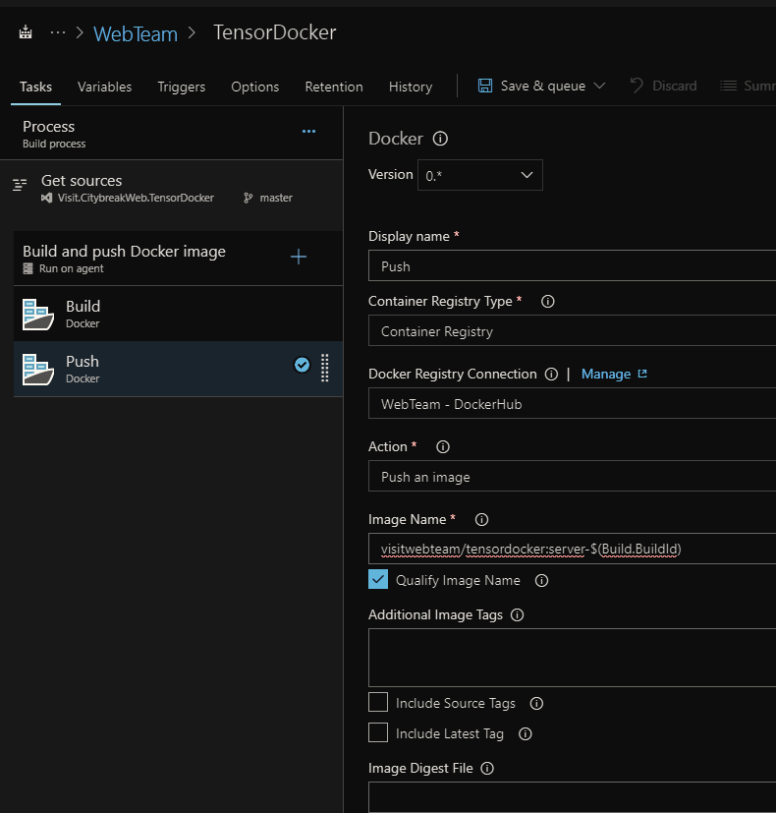
It builds! Deploy!

Slide 10
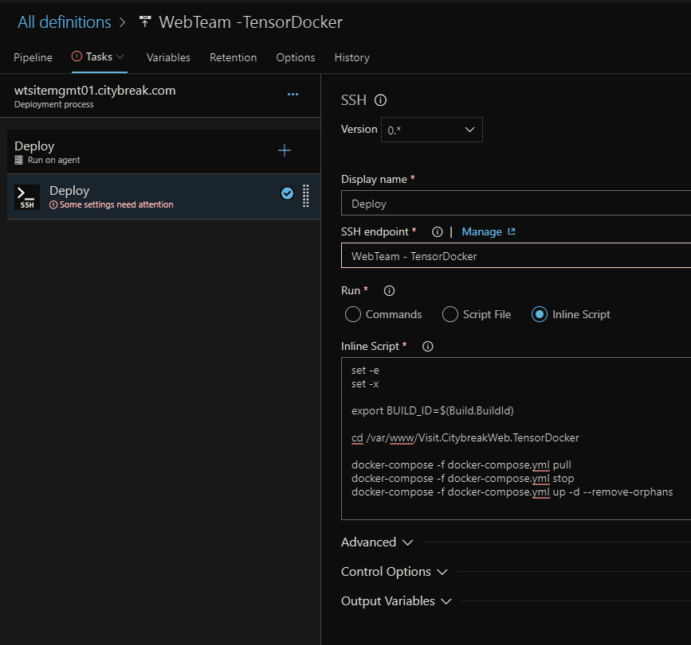
It builds! Deploy!

Slide 11
Next steps:
HTTPfiy client
Dockerify trainer
Move to Hello World to a real case
Profit!

Slide 12
You gotta have da cat!

